Slide 1
Fluid Flow in Pipes
Group 1
Miguel Piza
Ify Bidokwu
Christian Salinas
Chemical Engineering Lab I
10/28/25

Slide 2
Introduction
The purpose of Fluid Flow in pipes is to utilize experimental measurements(Pressure Drops, Flow rates, Lengths etc.) to compare with empirical expressions for the friction factors, head loss and pipe fitting head loss.
The lab utilizes various pipe fittings and pipe diameters to investigate how those effect the results.
The lab will investigate the expressions for both laminar and turbulent flow regions.

Slide 3
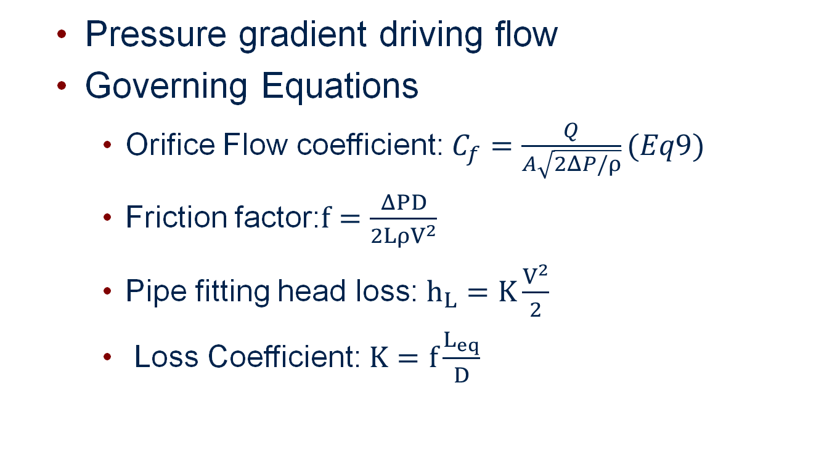
Theory
Pressure gradient driving flow
Governing Equations
Orifice Flow coefficient: $C_{f}=\frac{Q}{A\sqrt{2ΔP/ρ}}(Eq9)$
Friction factor:$f=\frac{ΔPD}{2LρV^{2}}$
Pipe fitting head loss: $h_{L}=K\frac{V^{2}}{2}$
Loss Coefficient: $K=f\frac{L_{eq}}{D}$

Slide 4
Theory
Assumptions
Near constant density
Incompressible fluid
Limitations
Limits in pressure readings
The pressure drops are on the lower range of the meter’s range
Using the smaller flow valves the flow rate is unable to reach the same range as the large one
Data is not all in the same range

Slide 5
Apparatus
Reservoir Tank
Reservoir Release Valve
Pump power switch/pump
Pump inlet valve
Flow rate meter
Rotameter
Water flow control valves
Tubes (varying diameters)
Pipe fittings

Slide 6
Material & Supplies
Water
Reservoir Tank/Buckets
(2) Hoses with special connectors
Reads the pressure drop across selected fittings
Graduated Cylinders
Stopwatch Timer
Paper Towels

Slide 7
Procedure
Fill water in revisor tank
Prime and turn on the Pump
Open Flowmeter to a selected value
Use buckets to collect a volume of water for a selected amount of time
Repeat for 3-4 flow rates and graph the volumetric flow rates vs the reading of the flow rate in SCFM. The slope is the conversion factor. (Should be around .9)
Open the flowmeter to a decided upon value and use the flow needles to measure the pressure drop across
Repeat for all fittings for four different flow rates

Slide 8
Procedure
After the fittings are measures open only the flow gauge for the system of pipes you are investigating
Measure the pressure drop across one pipe at a time. Ensure only one pipe has water flowing through it.
Repeat for all nine pipes at four different flow rates.
For all pressure readings record for 20-30 seconds taking down the pressure and taking the average
Measure all lengths and diameters of all fittings and pipes.
Close flow gauges and open release vales after shutting pump off

Slide 9
Experimental Challenges
The smaller pipes cannot reach the same flow rate as the larger one.
Data will not be in the same SCFM.
Make sure the flowrate is recorded for each trial
Ensure a dry space as leaks occur.

Slide 10
Safety
Pressure Hazards
Do not run the pump dry will it to break
Ensure there is always a way for the water to exit the system
Mechanical Hazards
Slipping hazards
Water tends to leak from various places in the system
Use buckets to collect it as you run your experiments.

